Slide 1

Academic Session 2025-26
ODD Semester Jul-Dec 2025
UNIVERSITY INSTITUTE OF ENGINEERING
COMPUTER SCIENCE ENGINEERING
Bachelor of Engineering
Semester: 6th
Design and Analysis of Algorithms
(23CSH-301/ITH-301)
Unit No. 1 Chapter No. 3 Lecture No. 12, 13
Topic : Counting sort, radix sort
Richa Dhiman E11307 Assistant Professor

Slide 2
1
Learning Objectives & Outcomes
Objective:
To understand Sorting algorithm In Linear Time
Outcome:
Student will understand Sorting algorithm In Linear Time.

Slide 3
2
Counting Sort
Counting sort is a stable sorting technique, which is used to sort objects according to the keys that are small numbers. It counts the number of keys whose key values are same. This sorting technique is effective when the difference between different keys are not so big, otherwise, it can increase the space complexity.

Slide 4
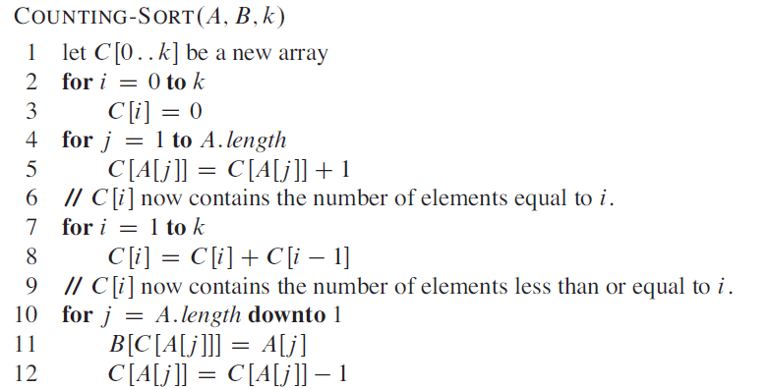
3
Counting Sort: Algorithm

Slide 5
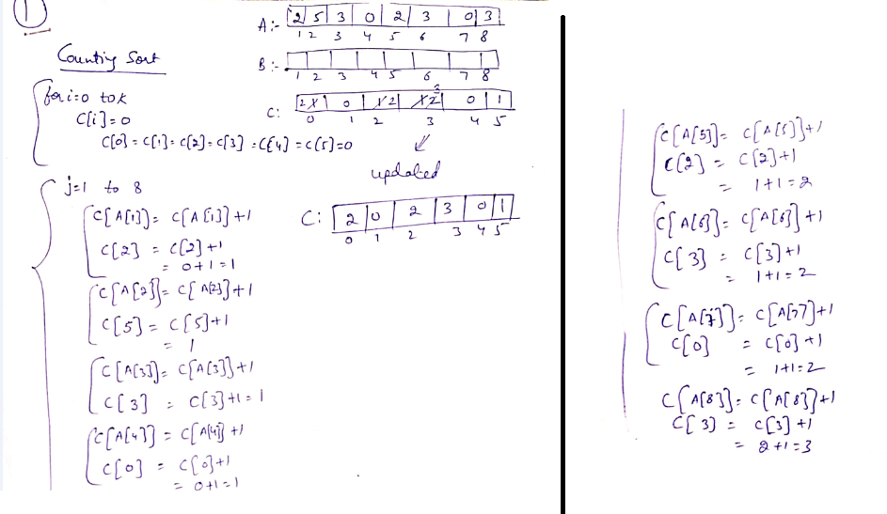
4

Slide 6
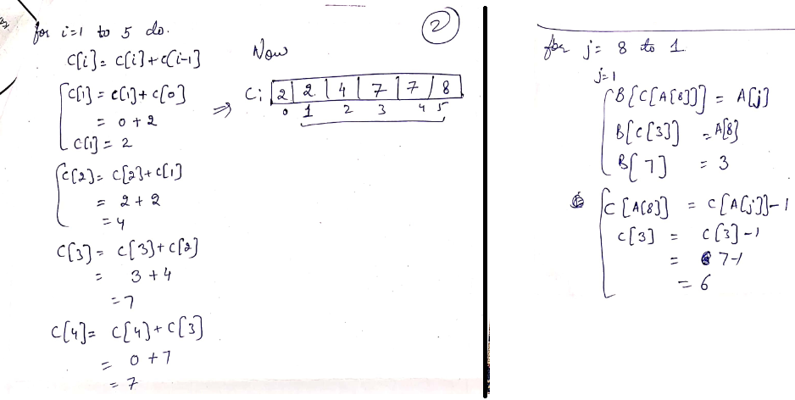
5

Slide 7
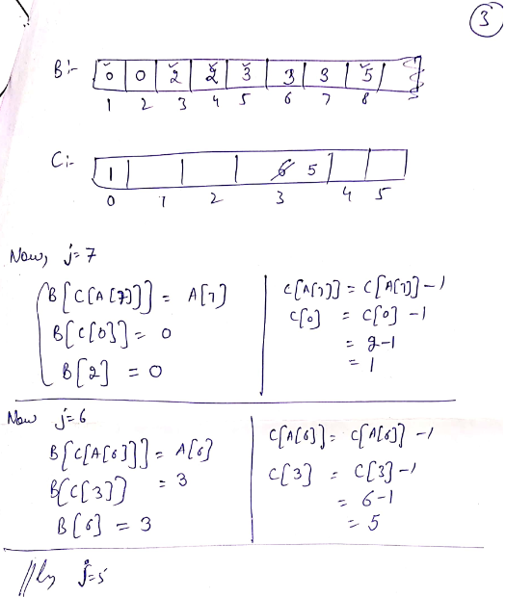
6

Slide 8
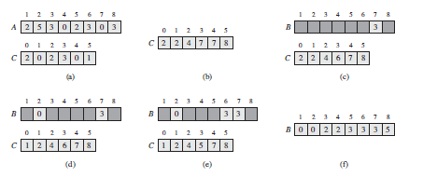
Example
7

Slide 9
Radix Sort
7
Radix sort is a sorting technique that sorts the elements by first grouping the individual digits of the same place value. Then, sort the elements according to their increasing/decreasing order.
Suppose, we have an array of 8 elements. First, we will sort elements based on the value of the unit place. Then, we will sort elements based on the value of the tenth place. This process goes on until the last significant place.

Slide 10
8
Radix Sort (Contd…)
The Radix Sort Algorithm
1) Do following for each digit i where i varies from least significant digit to the most significant digit.
a) Sort input array using counting sort (or any stable sort) according to the i’th digit.

Slide 11
9
What is the running time of Radix Sort?
Let there be d digits in input integers. Radix Sort takes O(d*(n+b)) time where b is the base for representing numbers, for example, for decimal system, b is 10. What is the value of d?
If k is the maximum possible value, then d would be O(log_{b}(k)). So overall time complexity is O((n+b) * log_{b}(k)).

Slide 12
7
Applications
Sorting integers within a small known range (e.g., exam scores, ages).
Sorting data with many duplicate values.
Used as a subroutine in Radix Sort.
Efficient sorting of fixed-range data in computer graphics (e.g., color values).
Histogram-based operations in image processing (e.g., grayscale histogram equalization).
Suffix array construction in string processing algorithms.
Sorting categorical or class label data in machine learning preprocessing.
Educational demonstrations of non-comparison-based sorting algorithms.
.

Slide 13
Summary
17
Sorting Algorithm in Linear Time
Radix Sort
Counting Sort
Bucket sort

Slide 14
18
Next Lecture
Sorting algorithm In Linear Time
(Bucket Sort)

Slide 15
19
Quiz
Counting Sort is best suited for: A) Large data with floating-point numbers B) Data with large ranges C) Data with a small range of integers D) Sorting linked lists
2. In Radix Sort, which sorting algorithm is typically used as a subroutine? A) Bubble Sort B) Insertion Sort C) Counting Sort D) Selection Sort

Slide 16
20
References/ Articles/ Videos
Text books:
Cormen, Leiserson, Rivest, Stein, “Introduction to Algorithms”, Prentice Hall of India, 3rd edition 2012. problem, Graph coloring.
Horowitz, Sahni and Rajasekaran, “Fundamentals of ComputerAlgorithms”, University Press (India), 2nd edition
Websites:
https://www.geeksforgeeks.org/counting-sort/
https://www.programiz.com/dsa/radix-sort

Slide 17
21
Faculty-curated videos, NPTEL, Coursera, LinkedIn, or other relevant learning resources
https://onlinecourses.nptel.ac.in/noc23_cs96/preview
https://nptel.ac.in/courses/106106131
https://nptel.ac.in/courses/106106208
https://www.linkedin.com/learning/learning-algorithms

Slide 18
23
Class-Wise Feedback

Slide 19
24
Thank You
For queries
Email: richa.e11307@cumail.in

